Slide 1
Clock Skew
The clock doesn’t arrive at all registers at same time
Skew: difference between two clock edges
Perform worst case analysis to guarantee dynamic discipline is not violated for any register – many registers in a system!

Slide 2
Setup Time Constraint with Skew
In the worst case, CLK2 is earlier than CLK1
T_{c} ≥ ?

Slide 3
Setup Time Constraint with Skew
In the worst case, CLK2 is earlier than CLK1
T_{c} ≥ t_{pcq} + t_{pd} + t_{setup} + t_{skew}

Slide 4
Setup Time Constraint with Skew
In the worst case, CLK2 is earlier than CLK1
T_{c} ≥ t_{pcq} + t_{pd} + t_{setup} + t_{skew}
t_{pd} ≤ T_{c} – (t_{pcq} + t_{setup} + t_{skew})

Slide 5
Hold Time Constraint with Skew
In the worst case, CLK2 is later than CLK1

Slide 6
Hold Time Constraint with Skew
In the worst case, CLK2 is later than CLK1
t_{ccq} + t_{cd} > t_{hold} + t_{skew}

Slide 7
Hold Time Constraint with Skew
In the worst case, CLK2 is later than CLK1
t_{ccq} + t_{cd} > t_{hold} + t_{skew}
t_{cd} > t_{hold} + t_{skew} – t_{ccq}

Slide 8
Parallelism
Two types of parallelism:
Spatial parallelism
duplicate hardware performs multiple tasks at once
Temporal parallelism
task is broken into multiple stages
also called pipelining
for example, an assembly line

Slide 9
Parallelism Definitions
Token: Group of inputs processed to produce group of outputs
Latency: Time for one token to pass from start to end
Throughput: Number of tokens produced per unit time
Parallelism increases throughput

Slide 10
Parallelism Example
Ben Bitdiddle bakes cookies to celebrate traffic light controller installation
5 minutes to roll cookies
15 minutes to bake
What is the latency and throughput without parallelism?

Slide 11
Parallelism Example
Ben Bitdiddle bakes cookies to celebrate traffic light controller installation
5 minutes to roll cookies
15 minutes to bake
What is the latency and throughput without parallelism?
Latency = 5 + 15 = 20 minutes = 1/3 hour
Throughput = 1 tray/ 1/3 hour = 3 trays/hour

Slide 12
Parallelism Example
What is the latency and throughput if Ben uses parallelism?
Spatial parallelism: Ben asks Allysa P. Hacker to help, using her own oven
Temporal parallelism:
two stages: rolling and baking
He uses two trays
While first batch is baking, he rolls the second batch, etc.

Slide 13
Spatial Parallelism
Latency = ?
Throughput = ?

Slide 14
Spatial Parallelism
Latency = 5 + 15 = 20 minutes = 1/3 hour
Throughput = 2 trays/ 1/3 hour = 6 trays/hour

Slide 15
Temporal Parallelism
Latency = ?
Throughput = ?

Slide 16
Temporal Parallelism
Latency = 5 + (10) +15 = 30 minutes = 1/2 hour
Throughput = 1 trays/ 1/4 hour = 4 trays/hour
Using both techniques, the throughput would be 8 trays/hour

Slide 17
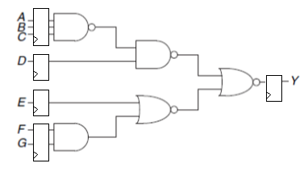
Temporal Parallelism
Compute max frequency, knowing that t_{pcq}=15ps t_{gate_pd}=40ps and t_{su}=65ps
Compute Latency
Compute Throughput

Slide 18
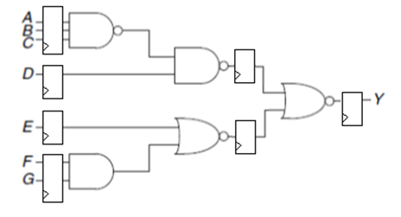
Temporal Parallelism
Compute max frequency, knowing that t_{pcq}=15ps t_{gate_pd}=40ps and t_{su}=65ps
Compute Latency
Compute Throughput

Slide 19
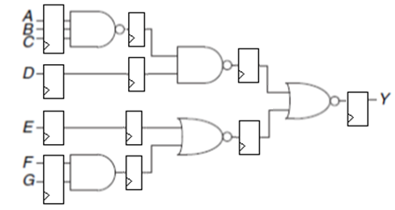
Temporal Parallelism
Compute max frequency, knowing that t_{pcq}=15ps t_{gate_pd}=40ps and t_{su}=65ps
Compute Latency
Compute Throughput

Slide 20
Esercizio FSM

Slide 21
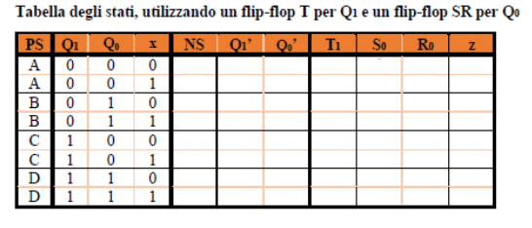
Esercizio FSM

Slide 22
Esercizio FSM

Slide 23
Esercizio FSM

